Slide 1

Taming Fragmentation-Induced Compatibility Issues in Android Apps
Lili Wei
The Hong Kong University of Science and Technology
2018-11-24

Slide 2

About Me
Lili Wei (lweiae@cse.ust.hk)
Advisor: Prof. Shing-Chi Cheung
B.Sc in Nanjing University (2011 – 2015)
PhD student in HKUST (2015 – present)
Research interests: program analysis and testing, mining code repositories, etc.
Taming Fragmentation-Induced Compatibility Issues in Android Apps

Slide 3
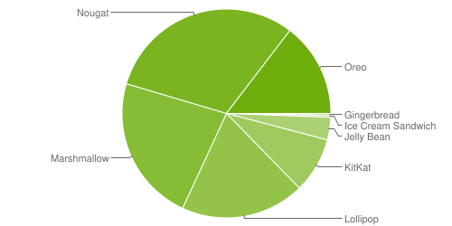
Android: Popular and Fast-Evolving System
Fast-evolving: multiple releases every year
Many different system versions in use:
https://developer.android.com/about/dashboards/

Slide 4
Huge Number of Device Models
Over 24,000 distinct device models (Aug. 2014 – Aug.2015)
https://opensignal.com/reports/2015/08/android-fragmentation/

Slide 5
Fragmented Android Ecosystem

Slide 6
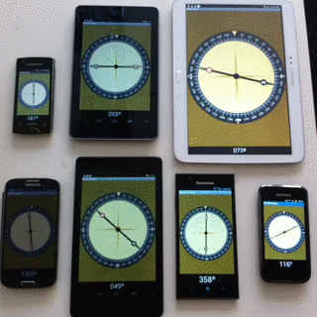
Android Fragmentation-Induced Compatibility Issues
An app can behave differently on different devices
Source: https://vine.co/v/MgWLMmmwUQQ

Slide 7

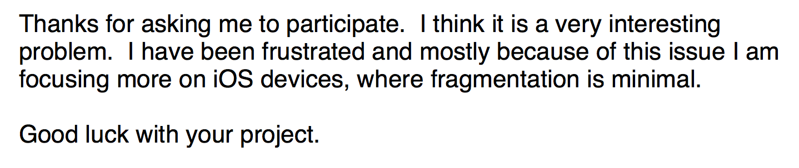

Slide 8
Our Goal

Slide 9



Study Design & Setup
An empirical study on 220 issues
A survey with 237 respondents
On-site Interviews with 5 practitioners

Slide 10
Understanding Compatibility Issues
RQ1: Issue type and root cause
RQ2: Issue-triggering context
RQ3: Issue consequence
RQ4: Issue testing
RQ5: Issue diagnosis and fixing

Slide 11
Issue Type & Root Causes
Non-device-specific issues
Can be triggered under certain API level
Device-specific issues
Can only be triggered on specific device models

Slide 12
Root Causes of Device-Specific Issues
Driver
Implementation
OS Customization
Hardware Composition

Slide 13
Root Causes of Non-Device-Specific Issues
API Evolution
Original System Bug

Slide 14
Issue Diagnosis & Fixing
Diagnosing compatibility issues is challenging
The search space for compatibility issues is huge (device model ☓ API level ☓ API)
The root causes of the compatibility issues are difficult to identify
Fixing compatibility issues
The patches are usually simple and demonstrate common patterns
Check device information (70%)
Check availability of software and hardware components (6.4%)
App-specific workarounds
1. +
2.
3. +
if (android.os.Build.VERSION.SDK_INT >= 16) {
sqLiteDatabase.disableWriteAheadLogging();
}

Slide 15
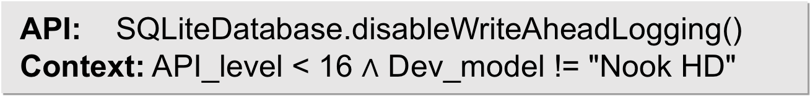
Compatibility Issue Detection
Common issue pattern
Compatibility issues are triggered by the improper use of an Android API (issue-inducing API) in a problematic software or hardware environment (issue-triggering context)
API-context pair model
Each pattern of compatibility issue is modeled as a pair of issue-inducing API and issue-triggering context
API: SQLiteDatabase.disableWriteAheadLogging()
Context: API_level < 16 $∧$ Dev_model != "Nook HD"
Notes:
在特定软硬件环境下调用可能引起问题的API造成的

Slide 16



FicFinder
Basic idea: To determine whether each callsite of an issue-inducing API is guarded by a condition checking the issue-triggering context
Android app
(.apk or .class)
Analysis Report
List of
API-context pairs

Slide 17

Evaluation Results
Accumulatively, FicFinder has detected 175 true positives in open-source Android apps
85 have been fixed
iSsO (1Sheeld developer)
Thanks, we will do it as you proposed in out next release. :)
Please let us know if you found more of these issues.

Slide 18


Limitations
Manually extracting API-context pairs is labor-intensive
Challenge:
Android compatibility issues are fast-evolving
Operating systems customized by different device manufacturers are commonly close-source
API: SQLiteDatabase.disableWriteAheadLogging()
Context: API_level < 16 $∧$ Dev_model != "Nook HD"
Can we automatically learn API-context pairs?

Slide 19
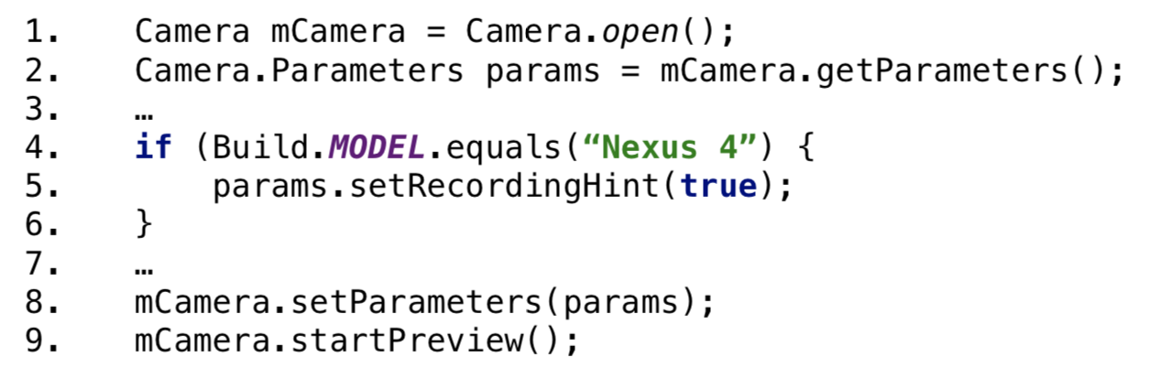
Learning API-Context Pairs Automatically
Observation: Mature Android apps contain code snippets handling compatibility issues
Automatically learn API-context pairs from code snippets handling compatibility issues in mature Android apps

Slide 20
Learning API-Context Pairs Automatically
Key challenge
How to identify valid API-context pairs for compatibility issues and filter out the noises?
Program analysis + mining code repositories
API-Context Pair Extractor
Pair Prioritizer
Ranked
API-context pairs
APK

Slide 21

Learning API-Context Pairs Automatically
Identified some API-context pairs that were not in our empirical study dataset
DatePicker crash on Samsung Galaxy Note 4 running Android 5.0

Slide 22
Conclusion
Characterize fragmentation-induced compatibility issues in Android apps
Propose FicFinder to automatically detect compatibility issues in Android apps
Automatically learn API-context pairs for fragmentation-induced compatibility issues
Related papers:
Understanding and Detecting Fragmentation-Induced Compatibility Issues for Android Apps [TSE 18] * Joint work with Peking University. To appear.
Taming Android Fragmentation: Characterizing and Detecting Compatibility Issues for Android Apps [ASE 16]

Slide 23
Thank you!
Lili Wei
The Hong Kong University of Science and Technology
http://sccpu2.cse.ust.hk/castle/index.html
http://home.cse.ust.hk/~lweiae/
http://sccpu2.cse.ust.hk/ficfinder/index.html

